Slide 1
Custom Aware
Epsilon Team

Slide 2
Introduce the problem
Overview of the project
Outline the benefits
Relevant to everyone in the room
Show it in action
Discuss the details of development
Conclusion

Slide 3

Super Bowl Winner
Uses machine learning to do predictive analysis
Uses data in Acumatica to train the model.
Expected Results:
Accurately predict the winning team.
Accurately final score.
Benefit: Everyone in this room can place a winning bet
Let me jump right in and show you.
Notes:
[Nick] “Our customization uses machine learning to do predictive analysis using data in Acumatica. We decided to predict the final score and winner of the Super Bowl. Let me jump right in and show you.”

Slide 4
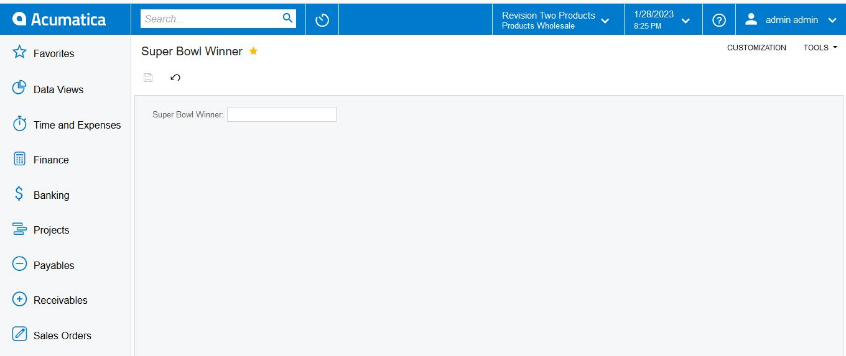
DEMO
Notes:
[Nick] “WAIT, what happened!”
[Nick] turns to [Luis] and says, “what happened?”
[Luis] holding phone “I got a notification moments ago saying that team ETA did a publish.”
[Nick] "Team ETA... where is that team? Who is on that?"

Slide 5
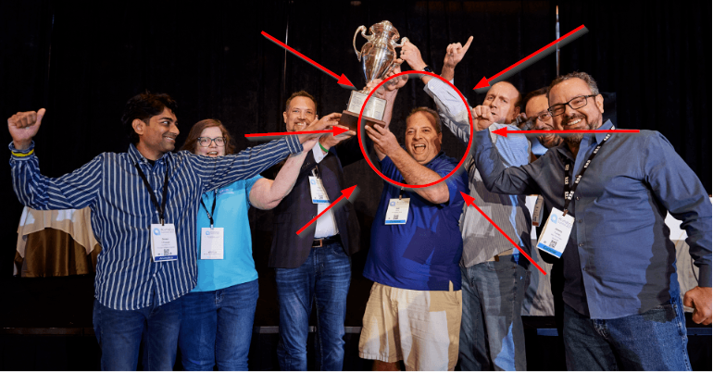
This Guy Really Wants To Win
Notes:
[Nick] "I think that guy really wants to win!"
Pause for laugh
[Nick] turns to [Luis] “You got a notification? With that kind of detail? I didn't think that existed?”

Slide 6
Custom Aware (The Real Project)
Help development and support teams to audit customization project publishing and unpublishing activities.
Enhance logging, auditing and notification on publications of customizations.
Extend the current functionality of Customization Projects Screen
Add author email, phone number, add extra space for notes about the package
Easily view published details
Send a notification to project stakeholders.
Notes:
[Luis] “It exists now. Our real project is enhanced logging, auditing and notification on publications of customizations. Author info has been extended on the customization projects screen. We've expanded the notes for the package. Made reviewing publication details easier. And enabled notification to stakeholders.”
Bring up the report in Acumatica

Slide 7

The Problem
Multiple VARs and customers managing multiple customization projects.
One of them publishes and downstream issues occur.
Sometimes not realized right away.
Scrambling to understand who, what, when, and why.
Notes:
[Nick] “That’s genius! This is something we deal with all the time. We have multiple VARs and customers that manage multiple customization and publishing often causes issues that are sometimes not realized right away. We are often scrambling to understand what happened, who did it ,and why. While the customer is breathing down our neck. I bet that everyone in this room would like this enhancement as part of the Acumatica core in the next release.”

Slide 8

Benefits
Immediate notification of publish activities to stakeholders.
Improves details on what was published, when, and why.
Reduces loss of functionality.
Faster root cause analysis.
Faster mean time to recovery.
Notes:
[Luis] “The beauty of this is it will send immediate notification to all the stakeholders that a customization was published, or in this case, unpublished. We are also logging details from the developer who performed the action to Acumatica.”

Slide 9
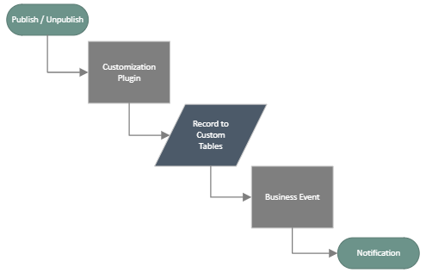

Slide 10




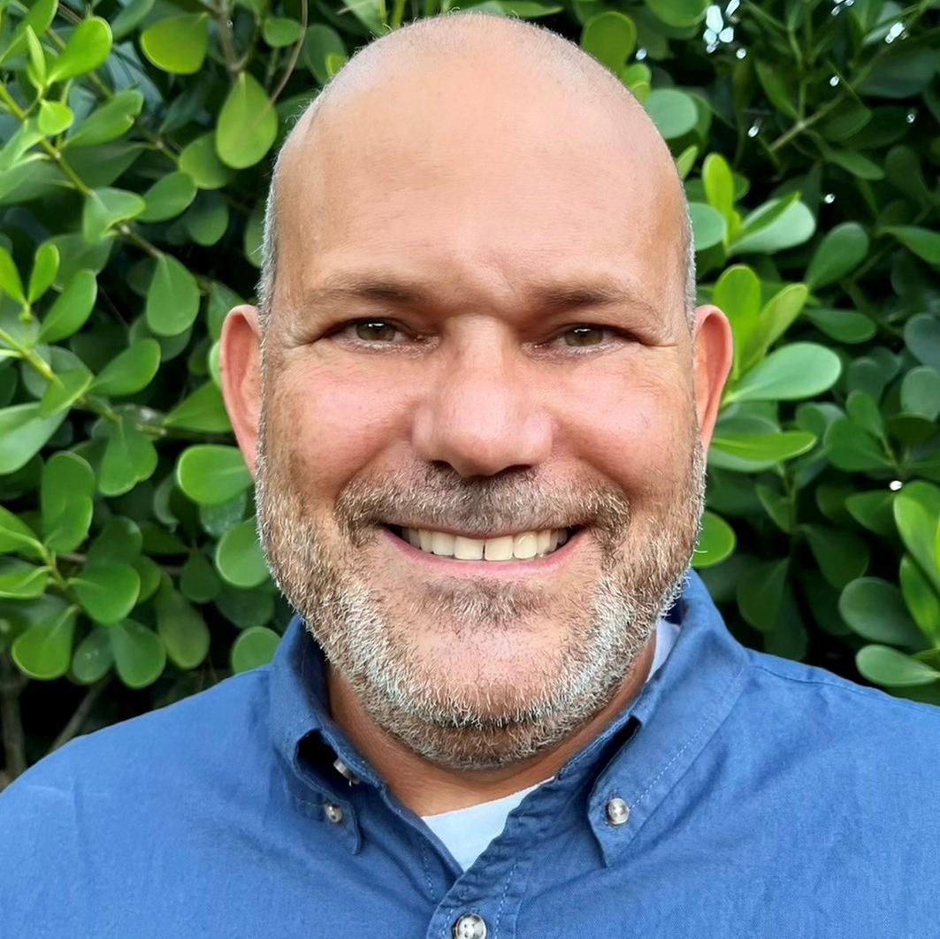





Joe Jacob
Stephane Belanger
Daryl Schlotthauer
Luis Palmer
Nick Tornese
Sr. Developer
CEO, MVP
Programmer
Director of Services
VP of IT

Slide 11
Super Bowl Prediction?
Notes:
[Nick] turns to [Luis] “So we don’t have a prediction for the Super Bowl?”
[Luis] “The Cincinnati Bangles will beat the Philadelphia Eagles in a game ending field goal by the score of 30-27”.

